Slide 1
Fundamentals of Digital Imaging
Part 5
File Size and File Compression

Slide 2
In this lecture, you will find answers to these questions
How do pixel dimensions affect the image file size?
How does the bit-depth affect the image file size?
Why should JPEG files NOT be used as working files for further editing?

Slide 3
Why Compression?
higher resolution or higher bit depth ⇒ larger file size
Without compression, image files would take up an unreasonable amount of disk space.
Larger files take longer time to transfer over the network.

Slide 4
How many bits?
Let’s look at the size of a typical high resolution image file without compression.

Slide 5
How many bits?
Suppose 6-megapixel digital camera may produce digital images of 3000 × 2000 pixels in 24-bit color depth.
Total pixels:
3000 × 2000 pixels = 6,000,000 pixels
File size in bits:
6,000,000 pixels × 24 bits/pixel = 144,000,000 bits
File size in bytes:
144,000,000 bits / (8 bits/byte) = 18,000,000 bytes ≅ 17 MB

Slide 6
Strategies To Reduce File Sizes
Reducing the pixel dimensions
Lowering the bit depth (color depth)
Compress the file

Slide 7
Reducing Pixel Dimensions
Capture the image at a lower resolution in the first place
Resample (resize) the existing image to a lower pixel dimensions

Slide 8
Reducing Pixel Dimensions
Returning to our calculation of the file size of an image of 3000 × 2000 pixels in 24-bit color depth.
Let's calculate the file size of an image of 1500 × 1000 pixels in 24-bit color depth.

Slide 9
How many bits if half the size in each pixel dimension?
Total pixels:
1500× 1000 pixels = 1,500,000 pixels
File size in bits:
1,500,000 pixels × 24 bits/pixel = 36,000,000 bits
File size in bytes:
36,000,000 bits / (8 bits/byte) = 4,500,000 bytes ≅ 4.3 MB
It's 1/4th of the file size.

Slide 10
Lowering the Bit Depth
Returning to our calculation of the file size of an image of 3000 × 2000 pixels in 24-bit color depth.
Let's calculate the file size of an image if we reduce the bit depth to 8-bit.

Slide 11
How many bits if reduced to 8-bit?
Total pixels:
3000 × 2000 pixels = 6,000,000 pixels
File size in bits:
6,000,000 pixels × 8 bits/pixel = 48,000,000 bits
File size in bytes:
48,000,000 bits / (8 bits/byte) = 6,000,000 bytes ≅ 5.7 MB
It's 1/3rd of the file size.

Slide 12
24-bit vs. 8-bit
24-bit:
2²⁴ (about 16 million) colors
8-bit:
2⁸ (about 256) colors

Slide 13
Weighing Bit Depth Against File Size
24-bit → 8-bit:
  You lose about 16 million colors!
  May cause image quality degradation.
But 8-bit will work well if your image does not need more than 256 colors.

Slide 14
24-bit → 8-bit Without Noticeable Image Quality Degradation
Grayscale images: e.g.
  scanned images of black-and-white photos
  hand-written notes (may be even lowered to 4-bit, 2-bit, or 1-bit)
Illustration graphics: e.g. poster or logo
  contains only a few colors as large areas of solid colors

Slide 15
File Compression Methods
File compression:
To reduce the size of a file by squeezing the same information into fewer bits.
Lossless compression method:
  e.g., TIFF, PNG, PSD
  No information is lost
  GIF files also use lossless compression but it limits the number of colors to 256
Lossy compression method:
  e.g., JPEG
  Some information is lost in the process.
  For digital media files, the information to be left out is chosen such that it is not the human sensory system most sensitive to.

Slide 16
Working with Lossy Compression
JPEG files:
  JPEG compression, which is lossy (i.e., the lost information cannot be recovered)
  Do not use JPEG files as working files for further editing
  Repeated saving a JPEG file will degrade the image quality further
  Save as JPEG only in the very last step of your editing process. For example, when you have finished editing the image and are ready to post it on the Web.
  Avoid using JPEG for images intended for high quality prints

Slide 17
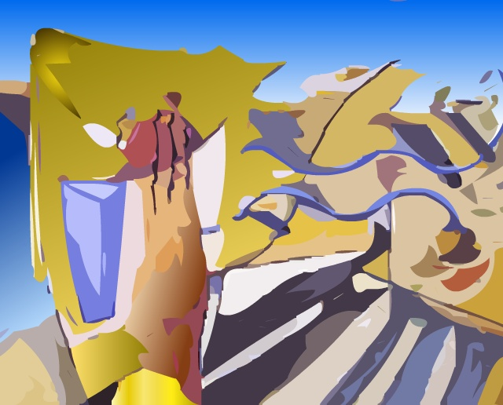
An original TIFF image

Slide 18
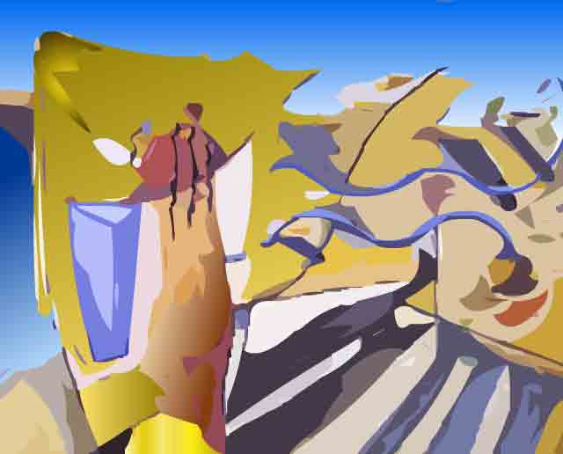
A JPEG with a very low quality setting.
Note the ugly artifacts around the contrast edges.

Slide 19
Closeup view of the JPEG with a very low quality setting.
Note the blockiness and ugly artifacts around the contrast edges.

Slide 20
File Types During Editing or Capturing
PSD
PNG
TIFF
camera RAW

Slide 21
Common File Types of Pixel-based Images
File Type | File Suffix | Standard Color Modes | Use | Compression
JPEG (Joint Photographic Experts Group) | .jpg .jpeg | RGB CMYK | Best for continuous tone images such as photographs can be used for Web images | Lossy compression method called JPEG compression that works well with photographs

Slide 22
Common File Types of Pixel-based Images
File Type | File Suffix | Standard Color Modes | Use | Compression
GIF (Graphics Interchange Format) | .gif | Indexed color, grayscale | Supports up to 8-bit color Best for illustration graphics or cartoon-like pictures with large blocks of solid color and clear divisions between color areas a proprietary format of CompuServe can be used for Web images | Lossless compression method called LZW compression

Slide 23
Common File Types of Pixel-based Images
File Type | File Suffix | Standard Color Modes | Use | Compression
PNG (Portable Network Graphics) | .png | indexed, grayscale, black and white | Supports 8-bit and 24-bit color Can be used for Web images | Lossless compression

Slide 24
Common File Types of Pixel-based Images
File Type | File Suffix | Standard Color Modes | Use | Compression
TIFF (Tag Image File Format) | .tif .tiff | RGB, CMYK, CIE-Lab, indexed, grayscale, black and white | Proprietary format of Adobe Photoshop good for any types of digital images that Photoshop supports stores layers supports alpha channel | Lossless compression

Slide 25
Common File Types of Pixel-based Images
File Type | File Suffix | Standard Color Modes | Use | Compression
PSD (Photoshop Digital Image) | .psd | RGB, CMYK, CIE-Lab, indexed, grayscale, black and white | Supported on both Windows and Mac common file format supports alpha channel | Allows uncompressed, LZW compression (lossless), ZIP (lossless), JPEG (lossy)

Slide 26
Common File Types of Vector Graphics
File Type | File Suffix | Information and Use
Encapsulated PostScript | .eps | Standard file format for storing and exchanging files in professional printing
Adobe Illustrator file | .ai
Adobe Flash file | .fla .swf
Windows Metafile format | .wmf | Many cliparts from Microsoft Office are in this format
Enhanced Metafile format | .emf | Developed by Microsoft as a successor to .wmf

